Slide 1
When to use which Charts?
Examples from real life
Content Creator:
Rishabh Pugalia (YodaLearning.com | ExcelSuperStar.org)

Slide 2
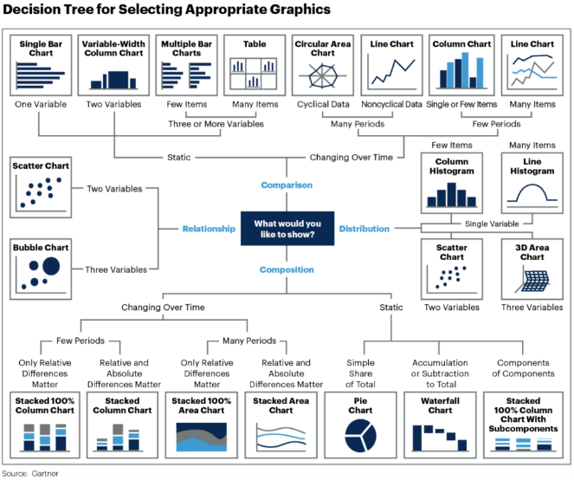
Such visual infographics are appealing but…
… aren’t easy to use for daily operations.

Slide 3
Generic advice doesn’t help your get your job done
Be precise
Be concise
Tell a story
Use font size 12 …

Slide 4
Did just someone ask for video recordings?

Slide 5
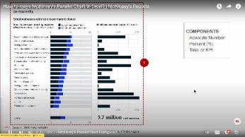
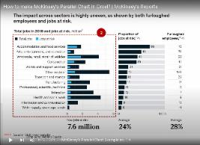
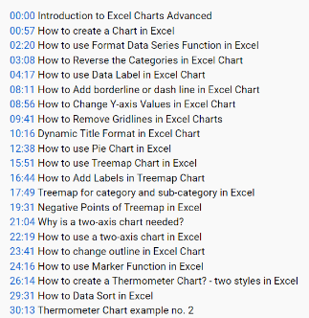
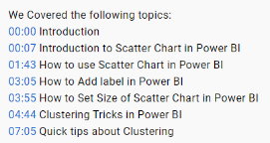
Bookmark this: Video Links for Charts (Excel & PowerPoint):
#1: How to make McK’s Parallel/Side-by-Side Chart in Excel?
Video Link (Eng): https://youtu.be/D1zC7IJzYw0 (~30 mins)
#2: 15 Excel Charts for Consulting presentations (~1 hr.)
Video Link (Hin): https://youtu.be/IpQewCnYBGY
Check video description for timestamps👉

Slide 6
Bookmark this: Video Links for Power BI
Yoda Learning's YouTube Video Links for Exploratory Analysis -
Calendar, Matrix Heatmap, Infographic Designer, Clustered Column Analytics=
https://www.youtube.com/watch?v=VpeLFZdUvNA&ab_channel=YodaLearningAcademy
Scatter (X-Y)=
https://www.youtube.com/watch?v=0RVNkemPmRY&ab_channel=YodaLearningAcademy
Decomposition Tree=
https://www.youtube.com/watch?v=Lb5Vn8E7U2Q&ab_channel=YodaLearningAcademy
Special Mention -
Small Multiples (Trellis)= https://www.youtube.com/watch?v=Y1Yz3OnurBs – from Pragmatic Works

Slide 7
Let’s start with something practical

Slide 8
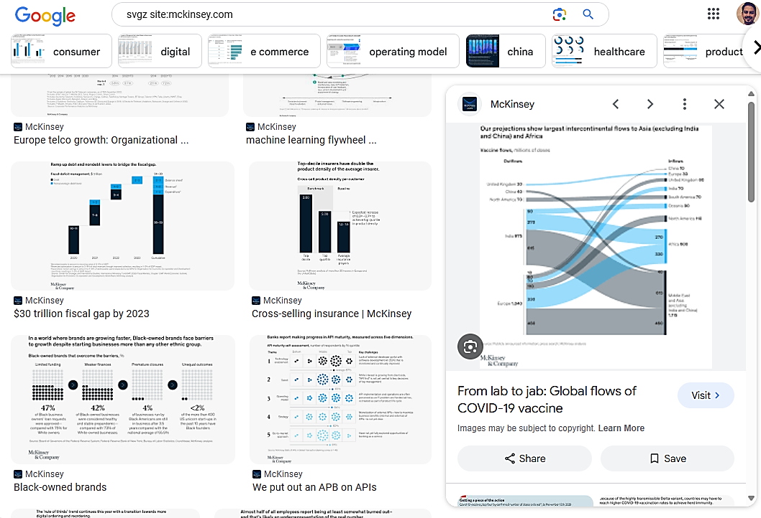

Practical Trick - How to learn from your competition?
#1. Google -
svgz site:mckinsey.com
gif site:bain.com
chart site: economist.com
#2. Click on the Images tab
#3. Add the keyword of industry or topic name – e.g., logistics, fintech, upi
FAQ: Right-click on a website’s image to “Save As” → to find out the image format (jpg, png, svgz, gif).
Disclaimer: This technique doesn’t work when a website doesn’t use image format standards consistently.
Video Recording: https://youtu.be/fogzhLpZq1Y
Notes:
jpg site:www.navalmanack.com/almanack-of-naval-ravikant
svgz site:mckinsey.com
gif site:bain.com
png site:ey.com/en_in

Slide 9
Practical Trick - How to learn from your competition?
#1. Google -
svgz site:mckinsey.com
gif site:bain.com
#2. Click on the Images tab
#3. Add the keyword of industry or topic name – e.g., logistics, fintech, upi
How to look at data using topic-specific perspectives, KPIs, Metrics, etc.
FAQ: Right-click on a website’s image to “Save As” → to find out the image format (jpg, png, svgz, gif).
Disclaimer: This technique doesn’t work when a website doesn’t use image format standards consistently.
Video Recording: https://youtu.be/fogzhLpZq1Y
Notes:
svgz site:mckinsey.com
gif site:bain.com
png site:ey.com/en_in

Slide 10
Mindset: Has this been done before?
It’s mostly about Google Search and using the right AI tools.

Slide 11
2-stage process of developing a data story

Slide 12
Where most professionals working with data get confused…
Data Exploring
Create “interactive” data visualizations that allow me and my team to find a story
[Example of a Power BI Dashboard with Slicer, Calendar Heatmap, Trellis/Small Multiple or an interactive Excel Pivot Table]
Data Explanation
What data to include to tell the right story (actionable insights, business impact)
[Example of McKinsey’s side-by-side comparison charts, SCQA framework; using the right charts, metrics and KPIs]
Source: www.storytellingwithdata.com/

Slide 13
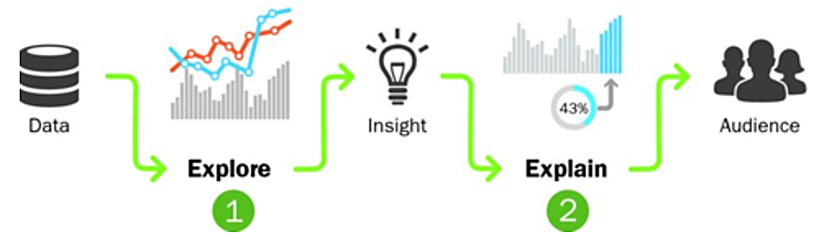
Where most professionals working with data get confused…
Picture Source: Effective Data Storytelling - by Brent Dykes
2-stage process for developing a data story.
Pattern
repeats in a recognizable way
Trend
general direction in which something is developing
Outlier
unlikely or rare event
Anomaly
result that can't be explained

Slide 14
Bookmark this: Video Links for Power BI
Yoda Learning's YouTube Video Links for Exploratory Analysis -
Calendar, Matrix Heatmap, Infographic Designer, Clustered Column Analytics=
https://www.youtube.com/watch?v=VpeLFZdUvNA&ab_channel=YodaLearningAcademy
Scatter (X-Y)=
https://www.youtube.com/watch?v=0RVNkemPmRY&ab_channel=YodaLearningAcademy
Decomposition Tree=
https://www.youtube.com/watch?v=Lb5Vn8E7U2Q&ab_channel=YodaLearningAcademy
Special Mention -
Small Multiples (Trellis)= https://www.youtube.com/watch?v=Y1Yz3OnurBs – from Pragmatic Works

Slide 15
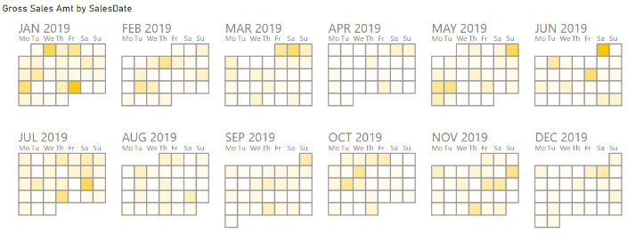
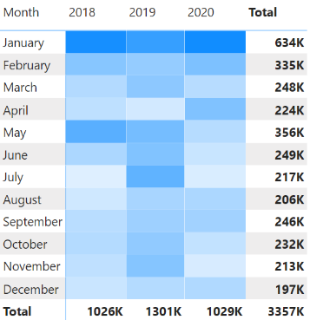
Use BI tools to explore data to gather insights

Slide 16
Chart Types
Line vs Column
Bar vs Pie
Pie vs Treemap
100% Bar
Waterfall
Thermometer
Trellis
Side by Side incl. Trellis
Base Normalization (Line)
Chart of Chart – Ideas
Calendar Heatmap
Waffle Visual
Bonus: 7 Storytelling Strategies including PowerPoint Shortcuts
Notes:
https://www.storytellingwithdata.com/letspractice/downloads

Slide 17
Creative Visuals from Power BI
Calendar Heatmap – Date Patterns
Sankey – Origin(s) and Destination(s)
Funnel

Slide 18
Let’s quickly cover the essentials

Slide 19
Let’s quickly cover the basics -
#1. Anatomy of a Chart
#2. Chart title vs. Slide title
#3. Editing and Configuring a Chart
#4. The obvious Dos and Donts
Notes:
svgz site:mckinsey.com
gif site:bain.com
png site:ey.com/en_in

Slide 20

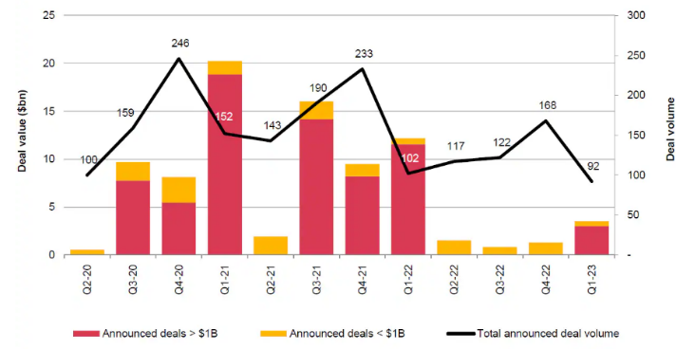
Anatomy of a Chart
Vertical Axis (Primary)
Vertical Axis (Secondary)
Data Labels
Axis-titles
Horizontal Axis (x-axis)
Data Series
Category Labels
Legends
Chart Source: www.pwc.com/us/en/industries/financial-services/library/insurance-deals-outlook.html
Notes:
svgz site:mckinsey.com
gif site:bain.com
png site:ey.com/en_in

Slide 21
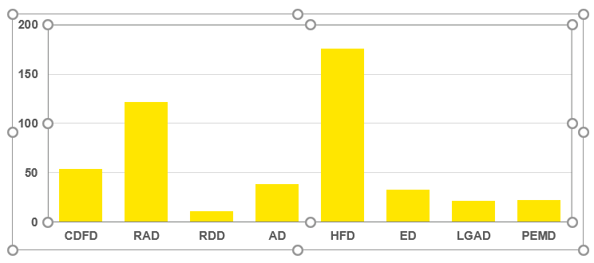
Anatomy of a Chart
Chart area includes the Plot area

Slide 22
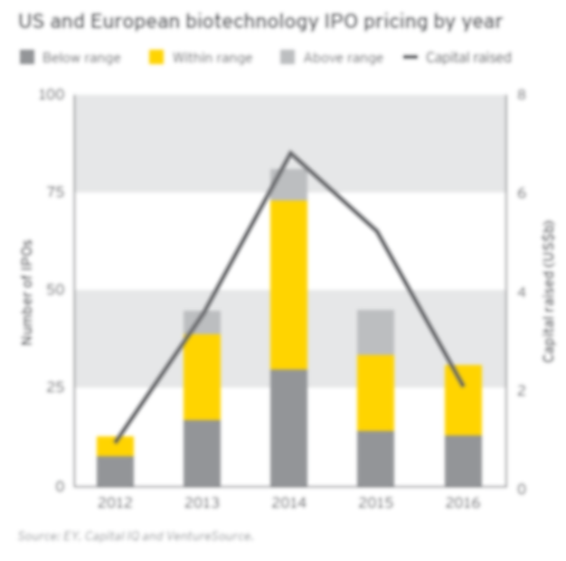
Anatomy of a Chart - Legends
Source: EY report

Slide 23
Anatomy of a Chart – Axis Titles
Axis-titles must have a unit of measurement
Source: EY report

Slide 24
Anatomy of a Chart – Source & Footnotes
Time validity of the data (if applicable)
…as of 31-Oct-2018
No acronyms without reference in the footnote

Slide 25
Let’s quickly cover the basics -
#1. Anatomy of a Chart
#2. Chart title vs. Slide title
#3. Editing and Configuring a Chart
#4. The obvious Dos and Donts
Notes:
svgz site:mckinsey.com
gif site:bain.com
png site:ey.com/en_in

Slide 26
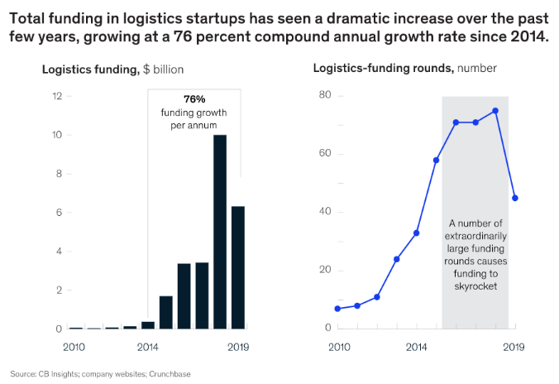
Chart Title vs. Slide Title
Slide Title (inference)
Chart Title (metric)
Source: https://www.mckinsey.com/industries/travel-logistics-and-infrastructure/our-insights/startup-funding-in-logistics

Slide 27
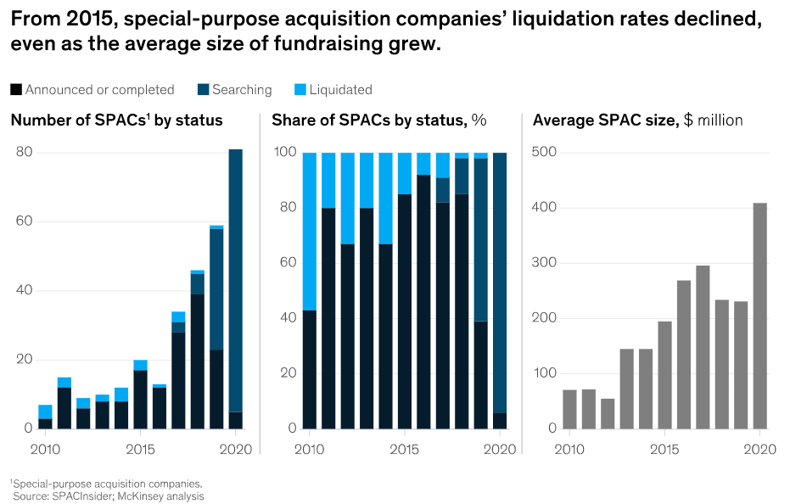
Chart Title vs. Slide Title
Slide Title (inference)
Chart Title (metric)
Source: https://www.mckinsey.com/industries/private-equity-and-principal-investors/our-insights/earning-the-premium-a-recipe-for-long-term-spac-success

Slide 28
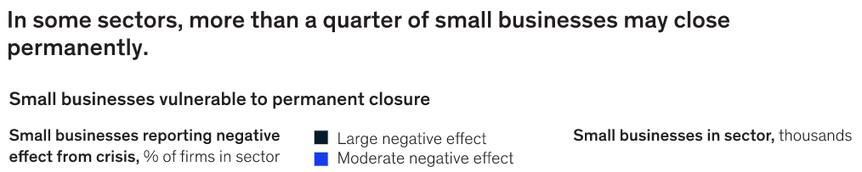
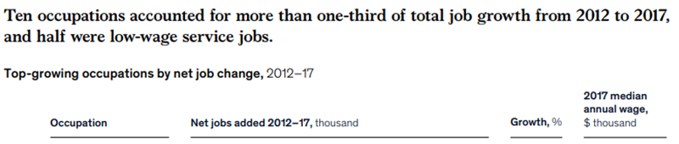
FYR: Slide Title vs. Chart Title – Examples
Slide Title (inference)
Slide Title (inference)
Source: McKinsey Website

Slide 29
FYR: Slide Title vs. Chart Title – Examples
Chart Title (metric)
Chart Title (metric)
Source: McKinsey Website

Slide 30
Exercise: Differentiate between Chart Title vs. Slide Title
Data usage on mobile devices in India reached levels of some of the developed markets in 2017
GDP growth rate and incremental jobs created in nine key sectors
40% of current service transactors have purchased products online, but then stopped for multiple reasons
Breakup of the respondents by sector
FDA product approvals, 1996–2016

Slide 31
Let’s quickly cover the basics -
#1. Anatomy of a Chart
#2. Chart title vs. Slide title
#3. Editing and Configuring a Chart
#4. The obvious Dos and Donts
Notes:
svgz site:mckinsey.com
gif site:bain.com
png site:ey.com/en_in

Slide 32
Alert – Practice Exercise ahead

Slide 33
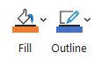
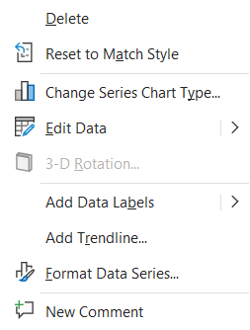
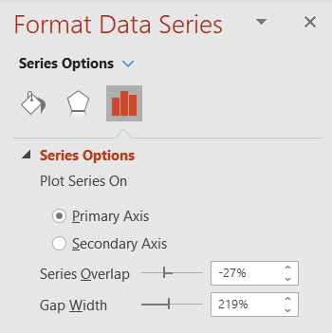


Essential Chart Settings
1
2
3
Practice
Notes:
svgz site:mckinsey.com
gif site:bain.com
png site:ey.com/en_in

Slide 34
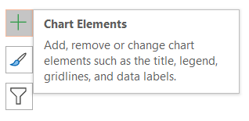

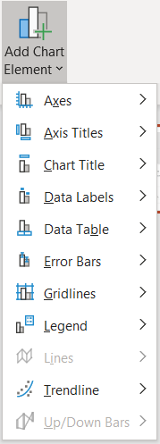
Essential Chart Settings (… cont’d)
4
5
Notes:
svgz site:mckinsey.com
gif site:bain.com
png site:ey.com/en_in

Slide 35
Essential Chart Settings - Practice
Estimated time: 45-60 mins
Dept. Name | Sales (US$ mn)
CDFD | 54
RAD | 122
RDD | 11
AD | 38
HFD | 176
ED | 33
LGAD | 21
PEMD | 22
Activity: Create this Chart in PowerPoint (NOT Excel):
Insert a Clustered Column Chart
Edit Data to - Sort (High to Low)
Change Series Chart Type to Horizontal Bar
Use Format Data Series to Reduce Gap width
Best Practice = Keep the Chart Width MORE than the Gap
Use – Categories in Reverse order (Y-axis format settings)
Add Data Label with one decimal (e.g., 176.0) using Numbers
Change color of all the series
Change color of one of the series
Convert Y-axis values = 0, 50, 100 …. 200 – to a different ‘jump’ value
Extra – Remove Gridlines, and bring it back
Extra - Add a thin border to one of the series (dashed, weight)
Extra – Duplicate the chart and change it to a Pie Chart
Extra – Highlight one slice and add the % value
Extra – Change the Angle of first slice
Notes:
svgz site:mckinsey.com
gif site:bain.com
png site:ey.com/en_in

Slide 36
Essential Chart Settings - Preview
Dept. Name | Sales (US$ mn)
CDFD | 54
RAD | 122
RDD | 11
AD | 38
HFD | 176
ED | 33
LGAD | 21
PEMD | 22
Sample Color Palette
Notes:
svgz site:mckinsey.com
gif site:bain.com
png site:ey.com/en_in

Slide 37
Essential Chart Settings - Practice
Dept. Name | Sales (US$ mn)
CDFD | 54
RAD | 122
RDD | 11
AD | 38
HFD | 176
ED | 33
LGAD | 21
PEMD | 22
Sample Color Palette
Notes:
svgz site:mckinsey.com
gif site:bain.com
png site:ey.com/en_in

Slide 38
Let’s quickly cover the basics -
#1. Anatomy of a Chart
#2. Chart title vs. Slide title
#3. Editing and Configuring a Chart
#4. The obvious Dos and Donts
Notes:
svgz site:mckinsey.com
gif site:bain.com
png site:ey.com/en_in

Slide 39
When to use Line Chart?

Slide 40
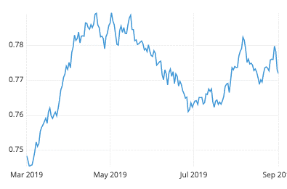
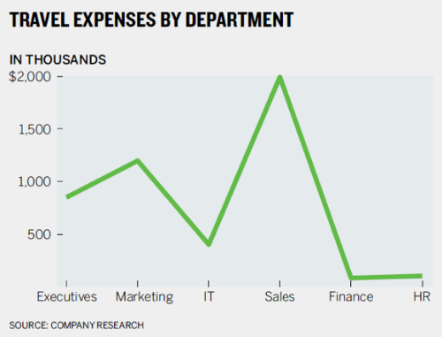


Line Chart – Use ONLY for Time Series data
LINE CHART = TIME SERIES

Slide 41
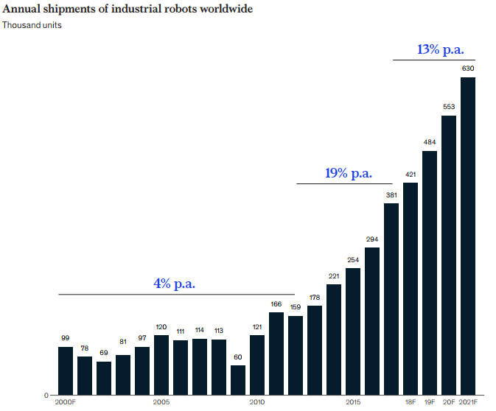
Column Chart can be used for time series if …
22 data points
Source: Chartio blog
~540 data points
… there is limited time series data points.
Source: McKinsey - Industrial-robotics-Insights-into-the-sectors-future-growth-dynamics

Slide 42
Choosing between Column vs. Line for Time Series
How many data points you are plotting?
fewer = column chart
more (many years) = line chart
US$ million
US$ million

Slide 43
When to use Horizontal Bar Chart over Pie Chart?

Slide 44
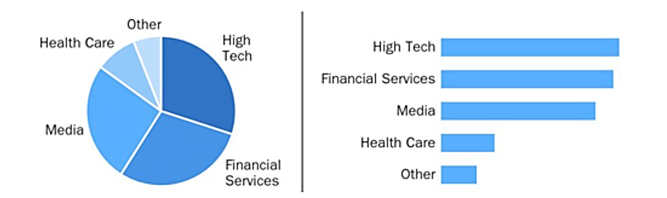
Pie vs. Bar Chart
Source: Effective Data Storytelling - by Brent Dykes
Notes:
https://www.forbes.com/sites/brentdykes/2019/09/12/10-ways-to-make-your-dashboards-more-actionable/?sh=53de3ec53e3c

Slide 45
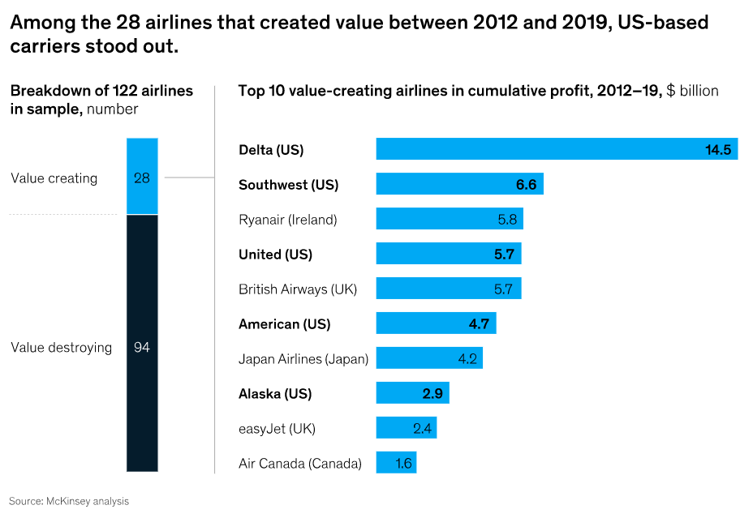
Category Labels

Slide 46
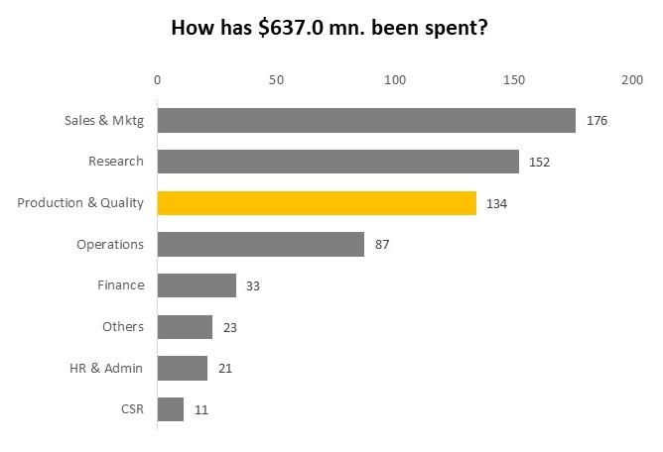
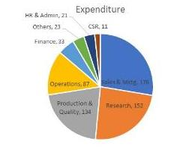
Why is Horizontal Bar Chart often preferred over Pie Chart?
Fit the lengthy Category Labels
Easier to compare rank-wise

Slide 47
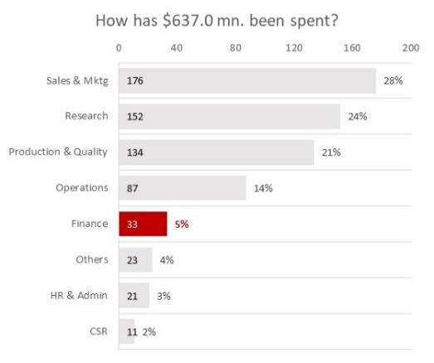
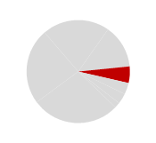
Horizontal Bar Charts (incl. one hidden chart for %) + Pie Chart
Dept. Name | Expenditure
Sales & Mktg | 176
Research | 152
Production & Quality | 134
Operations | 87
Finance | 33
Others | 23
HR & Admin | 21
CSR | 11

Slide 48
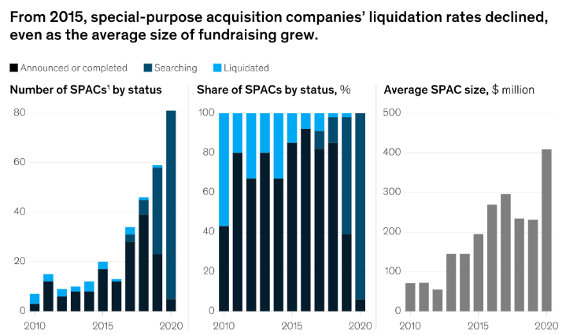
Different types of Column Chart
Stacked Column
100% Stacked Column
Column

Slide 49
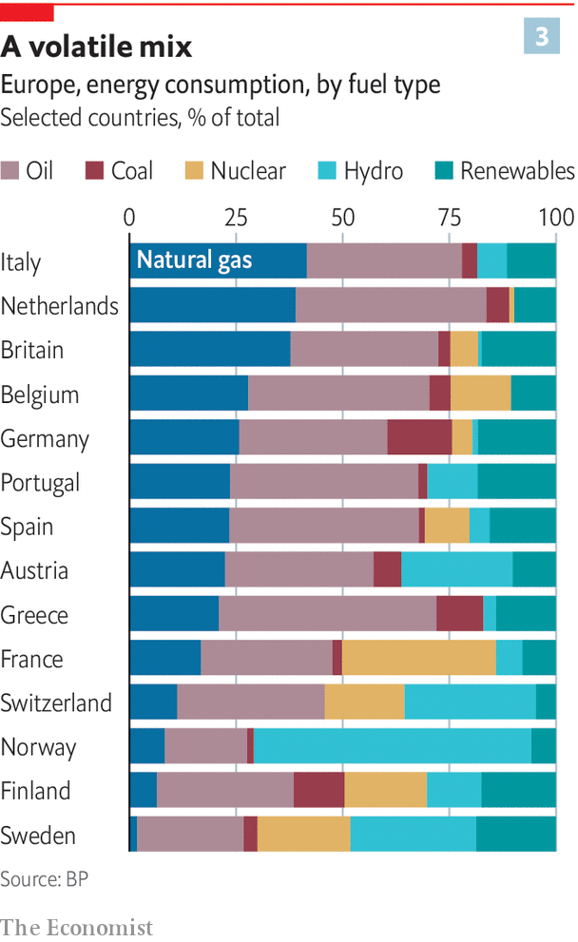
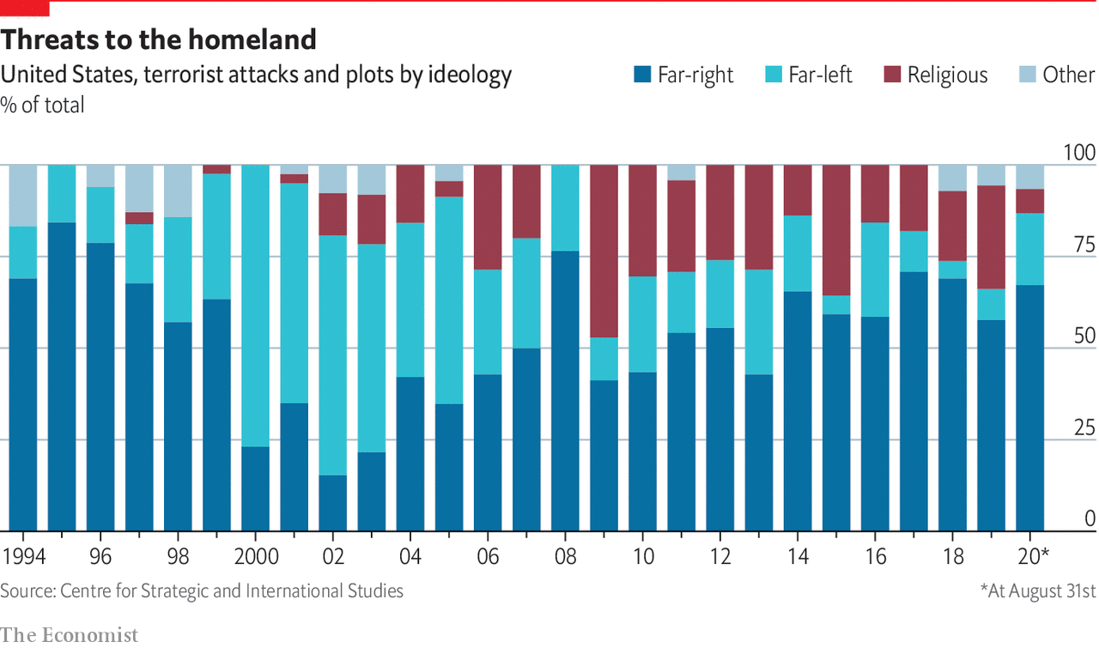
% Mix = Storytelling with 100% Stacked Bar / Column Chart
Image Source: The Economist

Slide 50
Choosing the right chart for different scenarios

Slide 51
Thermometer Chart

Slide 52
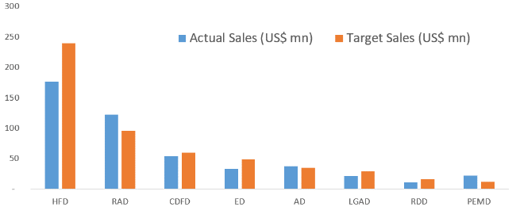
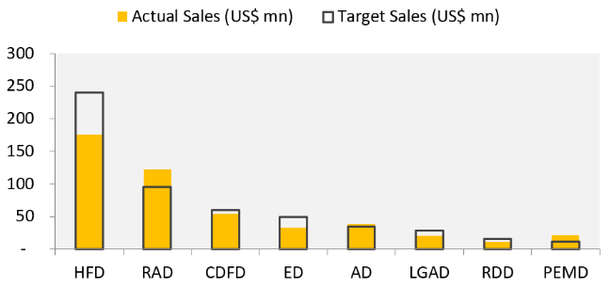

Slide 53

USE CASE:
THERMOMETER CHART
Compare 2 variables of the same scale -
1. Before vs After
2. LY vs CY
3. Actual vs Budget
4. Actual vs Target

Slide 54
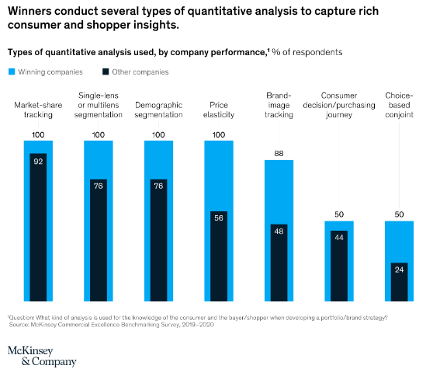
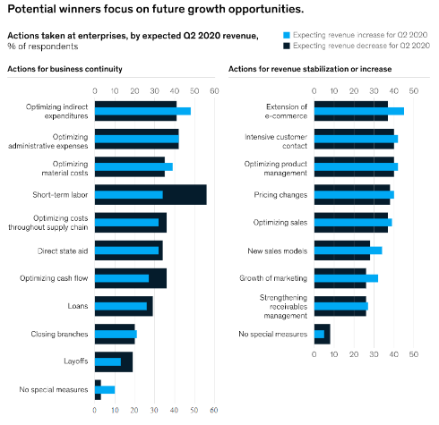
This is another variant -

Slide 55
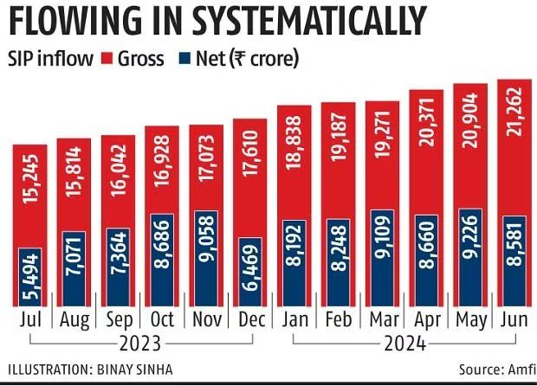

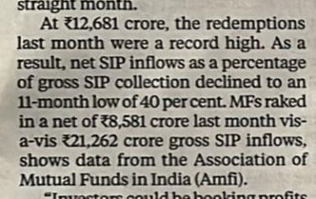
This is another variant (…cont’d) -
Source: Business Standard
Notes:
8581
12681
21262

Slide 56
Side-by-Side “Parallel” Chart – Type 1

Slide 57

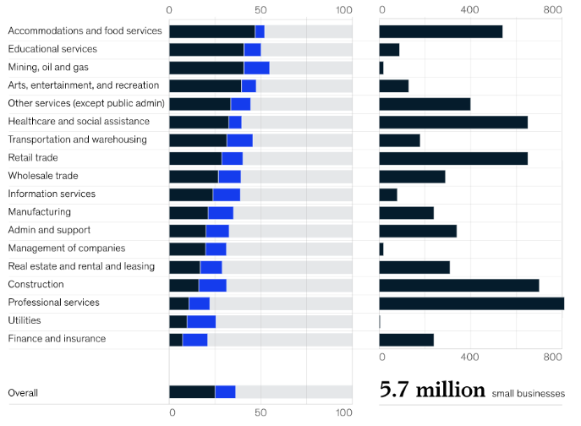
USE CASE:
1
Side-by-Side “Parallel” Chart – Type 1
1. Easy to read the lengthy category labels
2. Easy to compare vs. 2-axis line and column chart
3. KPI tiles with overall total
2
Trick:
Ctrl Shift and Drag
3
Source: McKinsey
Notes:
https://www.mckinsey.com/featured-insights/americas/which-small-businesses-are-most-vulnerable-to-covid-19-and-when

Slide 58
Data for practice:
Sector/Services | Large | Moderate | Low | No. of Busi.
Accommodations and food Services | 47 | 5 | 48 | 540
Educational services | 41 | 9 | 50 | 90
Mining, Oil and Gas | 41 | 15 | 44 | 20
Arts, entertainment, and recreation | 39 | 7 | 54 | 140
Other Services (except public admin) | 33 | 11 | 56 | 400
Healthcare and social assistance | 32 | 7 | 61 | 640
Transportation and warehousing | 31 | 14 | 55 | 170
Retail Trade | 28 | 12 | 60 | 650
Wholesale Trade | 26 | 13 | 61 | 290
Information Services | 23 | 15 | 62 | 80
Manufacturing | 21 | 14 | 65 | 240
Admin and Support | 20 | 12 | 68 | 340
Management of Companies | 18 | 11 | 71 | 10
Real Estate and Rental and Leasing | 16 | 12 | 72 | 310
Construction | 13 | 18 | 69 | 700
Professional Services | 10 | 12 | 78 | 800
Utilities | 9 | 16 | 75 | 5
Finance and Insurance | 6 | 14 | 80 | 240

Slide 59
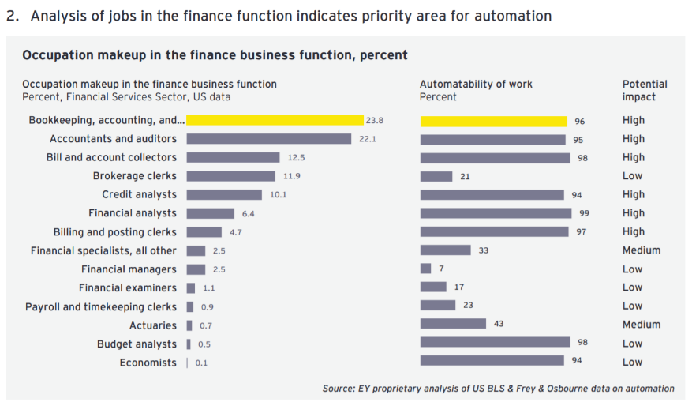
FYR: Side-by-Side “Parallel” Chart – Type 1
Source: EY reports

Slide 60
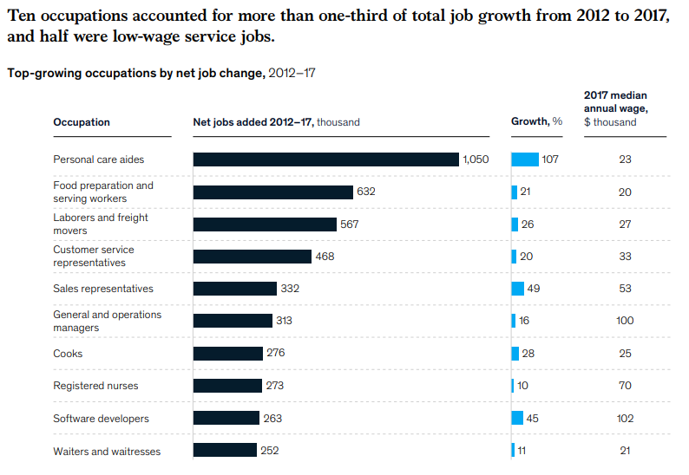
FYR: Side-by-Side “Parallel” Chart – Type 1
… with a Table
Source: McKinsey

Slide 61
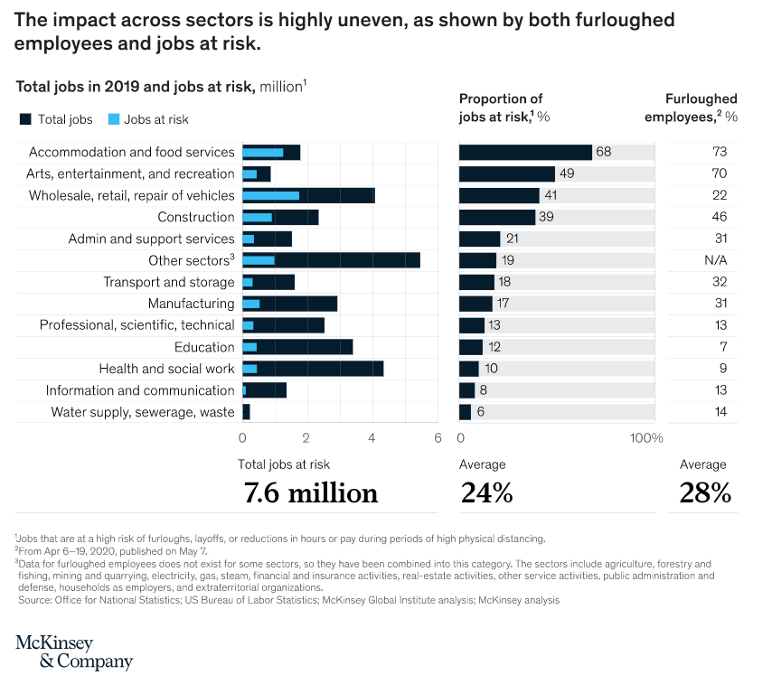
FYR: Side-by-Side “Parallel” Chart – Type 1
100% Stacked Bar
Thermometer Chart
KPI Tiles
Source: McKinsey

Slide 62
Data for practice
Sector/Services | Total Jobs | Jobs at risk
Water Supply, sewerage, waste | 0.3 | 0.1
Information and Communication | 1.4 | 0.2
Health and Social work | 4.3 | 0.4
Education | 3.4 | 0.4
Professional, scientific, technical | 2.5 | 0.3
Manufacturing | 2.9 | 0.6
Transport and Storage | 1.6 | 0.3
Other Sectors | 5.4 | 0.8
Admin and Support Services | 1.5 | 0.4
Construction | 2.4 | 0.8
Wholesale, retail, repair of vehicles | 4.1 | 1.6
Arts, entertainment, and recreation | 0.9 | 0.5
Accommodations and food Services | 1.8 | 1.2

Slide 63
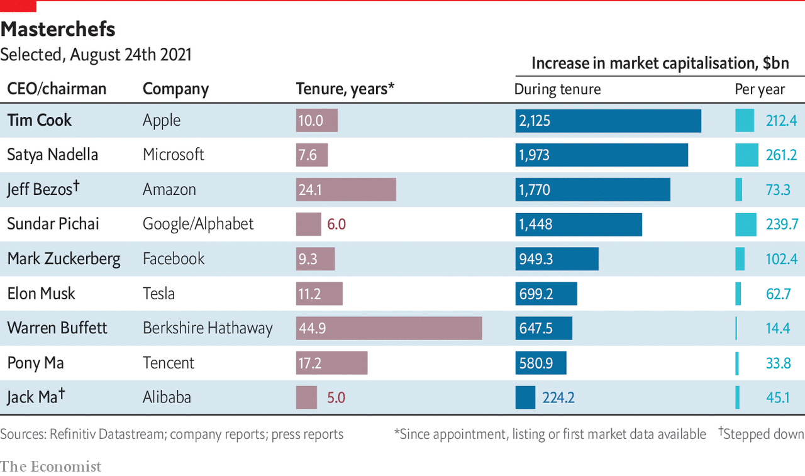
Side-by-Side comparisons
Power BI Tricks:
Matrix / Table
Data Bars
Image Source: The Economist

Slide 64
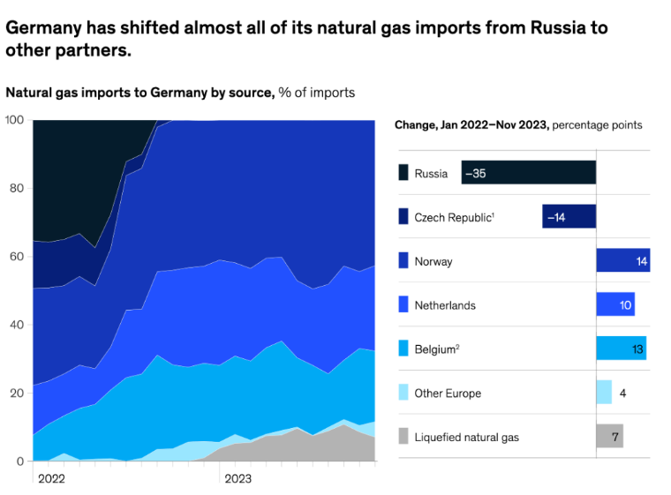
Side-by-Side comparisons
Source: EY reports

Slide 65
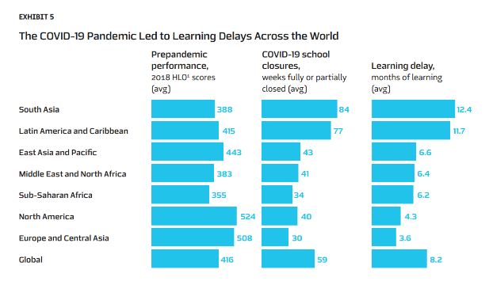
Side-by-Side comparisons
Notes:
https://www.mckinsey.com/~/media/mckinsey/industries/education/our%20insights/the%20skills%20revolution%20and%20the%20future%20of%20learning%20and%20earning/the-skills-revolution-and-the-future-of-learning-and-earning-report-f.pdf

Slide 66
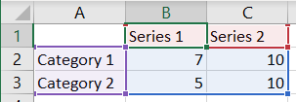
FYR: Advanced Tip - Clustered Bar with 100% overlap
Data setup
Progress Bar using Shapes
Clustered Bar with 2 axis =
Zero gap width
Series 100% overlap

Slide 67
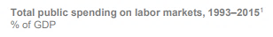
What do you understand from this chart?

Slide 68
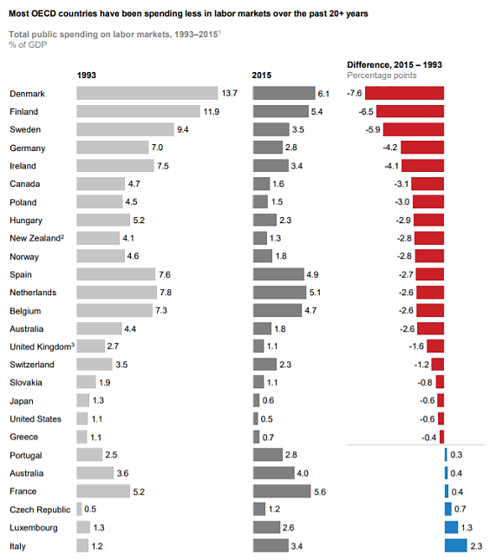

Slide 69
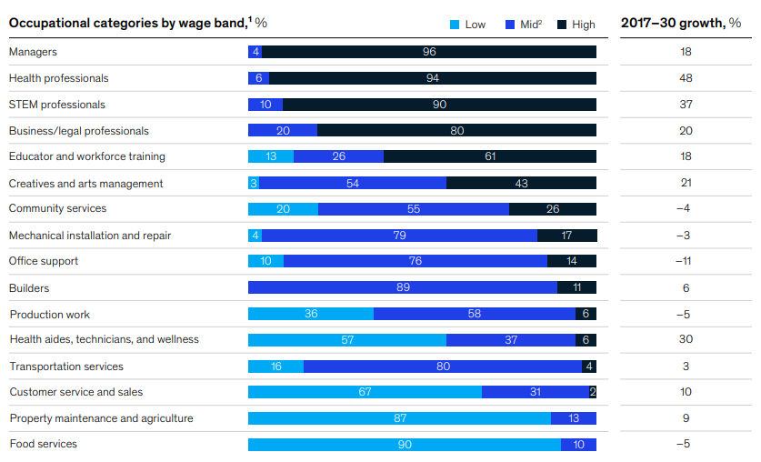
FYR: 1 Chart (100% Horizontal Stacked Bar) + 1 Table
Source: McKinsey

Slide 70

FYR: 1 Table + 1 Chart (100% Horizontal Stacked Bar)
League Table – NR companies
EBITDA-mix (%)
Which company will be affected the most if Iron Ore prices fall by 30%?
Which company is well diversified?
Source: Vedanta

Slide 71

How many of the 6 Storytelling Strategies have been used?
Image Source: McKinsey

Slide 72

Parallel Side by Side Bar Charts
Image Source: The Economist

Slide 73

Parallel Side by Side Charts
Image Source: The Economist

Slide 74
Side-by-Side “Parallel” Chart – Type 2

Slide 75

Use multiple perspectives to make a stronger argument
Assertion
Source: McKinsey Report

Slide 76

Use multiple angles to make your argument specific
Assertion
Waterfall Chart
Source: McKinsey Report

Slide 77

Use multiple angles to make your argument specific
Assertion
Source: McKinsey Report

Slide 78




FYR - Use multiple angles to make your argument exhaustive
Using Stacked Column Chart and100% Stacked Column Chart besides Column Chart
Source: McKinsey Report

Slide 79

FYR - Use multiple angles to make your argument exhaustive
Source: Bain Report

Slide 80

Storytelling with Column & Line Chart
Image Source: The Economist

Slide 81
Side-by-Side “Parallel” Chart – Type 3

Slide 82


Trellis layout for Line Charts (aka Small Multiples)
Source: YellowFinBI.com

Slide 83









Trellis helps compare trends on different scales
Hospitalizations Per Capita Due to Covid-19
vs
Power BI - equivalent:
Custom Visuals (Infographic Designer) or New Visual settings introduced in Dec 2020, called –”Small Multiples”
https://youtu.be/8bBqbpAgCqI
Sometimes referred as “Panel Charts”
Notes:
Source: https://www.bloomberg.com/graphics/covid-19-hospitalizations-us/

Slide 84

Trellis
Image Source: The Economist

Slide 85

Trellis
Source: McKinsey Report

Slide 86

Trellis
Using Chart of Chart technique to enhance the story flow
Source: McKinsey Report

Slide 87

Bonus tip: Idea for Chart of Charts
Source: J.P. Morgan report

Slide 88

Rebasing to 100
Notes:
Normalize base value

Slide 89

Line Chart with starting base as [100 or 1 or 0]
Source: McKinsey Report

Slide 90

Storytelling with rebasing the start point
Price per Troy Ounce
Rhodium – $4750
Palladium – $902
Platinum – $939
Notes:
https://www.mining.com/markets/commodity/rhodium/

Slide 91


Line Chart with starting base as 100
Source: McKinsey Report

Slide 92

Line Chart with starting base as 100
Indian rupee appreciated vs. US dollar due to expectations of higher fiscal deficits
Source: Bain & Co. report

Slide 93

Line Chart with starting base as 0%
Source: McKinsey Report

Slide 94
Heatmap (Excel to PowerPoint)
Notes:
Normalize base value

Slide 95

Storytelling with 100% Stacked Bar Chart
Image Source: The Economist

Slide 96
Storytelling with Heatmap
Tech Cons
Analytics
Div
Div
Div
Div
Div
Div
Div
Div
Div
Div
Div
Div
Div
Div
Div
Div
Div
Div
Div
Div
Div
Div
Div
Div
Div
Div
Div
Div
Div
Div
Div
Numbers:
Learning Hours
Count
Average Tenure
Billability (%)
Excel Tricks:
COUNTIFS, SUMIFS
Conditional Formatting
Cell Border Color
Paste Special
City 1
City 2
City 3
City 4
City 5
City 6
City 7
City 8
Power BI Tricks:
Matrix
Conditional Formatting
Image Source: The Economist

Slide 97

Heatmap
Made in Excel and then pasted in PowerPoint
Source: McKinsey Report

Slide 98



Heatmap technique (Excel to PowerPoint)
Hide text using ;;;

Slide 99
What else can you use in place of the Pie Chart?
Notes:
Normalize base value

Slide 100


Treemap is useful when you have - Category AND Sub-Category

Slide 101

Treemap vs. Pie Chart

Slide 102


Treemap is useful when you have - many categories
Dept. Name | Expenditure
Sales & Mktg | 176
Research | 152
Production & Quality | 134
Operations | 87
Finance | 33
Others | 23
HR & Admin | 21
CSR | 11
Too many category labels gets messy in a Pie Chart -

Slide 103
Exercise (self-practice): Create a Treemap
Dept. Name | Expenditure
Sales & Mktg | 176
Research | 152
Production & Quality | 134
Operations | 87
Finance | 33
Others | 23
HR & Admin | 21
CSR | 11

Slide 104

FYR: Treemap
Industry breakdown
Source: McKinsey Report

Slide 105


FYR: Donut with the “Total” in the centre
Source: McKinsey Report
Power BI tip: Use the Donut visual with a Card in the centre.
Keep the background color of the Donut as transparent and send the Card to the back (layering).

Slide 106
Waterfall

Slide 107

Waterfall Chart – History of buildup of power production capacity
USE CASE:
WATERFALL CHART
1. Show the sequence
2. Show the cumulative effect
3. Can be a mix of +/- ve values
- Stage-wise Value Addition
- Reconcile LY vs. CY Earnings
- Cost breakup (both +/- ve)
Source: Tata Power
Notes:
Source: Interworks

Slide 108

Waterfall Chart with Clustering & Callout
USE CASE:
WATERFALL CHART
1. Show the sequence
2. Show the cumulative effect
3. Can be a mix of +/- ve values
- Stage-wise Value Addition (+/-)
- Reconcile LY vs. CY Earnings
- Cost breakup (both +/- ve)
Source: Bain
Notes:
Source: https://www.bain.com/insights/pricing-global-private-equity-report-2020/
https://www.bain.com/insights/topics/global-private-equity-report/
https://www.bain.com/globalassets/noindex/2024/bain_report_global-private-equity-report-2024.pdf

Slide 109

Waterfall Chart with Clustering
USE CASE:
WATERFALL CHART
1. Show the sequence
2. Show the cumulative effect
3. Can be a mix of +/- ve values
- Stage-wise Value Addition
- Reconcile LY vs. CY Earnings
- Cost breakup (both +/- ve)
Source: Shell
Notes:
Source: Interworks

Slide 110

Waterfall Chart + Clustering + Callout
Notes:
Source: Interworks

Slide 111
X-Y (Scatter)

Slide 112

Pole Model or X-Y (Scatter) for trade-off analysis
More / +
Cost of Acquisition (CAC)
Zomato
CA practice firm
Scalable
X
Less / -
More / +
ZOHO
X-Y can be -
ARPU & Volume
Tech Skills vs. Verbal Communication
Less / -
Y
Notes:
https://twitter.com/rodinhood/status/1012652258511720448

Slide 113

X-Y Scatter to detect outliers
Notes:
Source: https://www.vizwiz.com/2020/11/makeovermonday-week-44-where-do-women.html

Slide 114


Using X-Y Scatter in Power BI
Video Link: https://www.youtube.com/watch?v=0RVNkemPmRY&ab_channel=YodaLearningAcademy

Slide 115
Self Reference: Annotations Tips for Charts

Slide 116

Label the lines vs. Legends
vs
India
Indonesia
US
…
Source: Bain & Co. report - report_unlocking_digital_for_bharat

Slide 117

[Before vs. After] Annual Shipments in the last 20 years
vs
Source: McKinsey - Industrial-robotics-Insights-into-the-sectors-future-growth-dynamics

Slide 118

Add an average line (dashed)
Source: EY reports

Slide 119
Chart of Charts
Source: J.P. Morgan report

Slide 120

Showing Estimates
Image Source: Bain

Slide 121


Showing + (joined) and – (left) along with net joined
Image Source: Bain
Notes:
https://www.bain.com/globalassets/noindex/2024/bain_report_global-private-equity-report-2024.pdf

Slide 122

Net Joined in different location
Image Source: Bain

Slide 123


100% Stacked
Image Source: Bain

Slide 124
Self-Referene: New-age charts

Slide 125

Sankey Chart in Power BI

Slide 126

Sankey Chart examples
Notes:
https://www.mckinsey.com/featured-insights/coronavirus-leading-through-the-crisis/charting-the-path-to-the-next-normal/from-lab-to-jab-global-flows-of-covid-19-vaccine

Slide 127


Sankey Chart examples
Notes:
https://www.bloomberg.com/graphics/covid-vaccine-tracker-global-distribution/

Slide 128

Chart of Charts (incl Merri Mekko)
Merri Mekko
Source: Bain & Co.

Slide 129

Refer EY app store (www.think-cell.com)

Slide 130

Use Cases of Think-Cell Add-in

Slide 131

Further reading: Gestalt principles of visual perception

Slide 132
End

